Slide 1
Image Restoration Using Inverse Filtering
Muhammad Hassan FA21-BCE-051
Sheryar Ahmed FA21-BCE-042
Supervised by:
Dr. Ayaz Ali Shah

Slide 2
Outline
Introduction
Literature Review
Proposed Solution
Results
Teamwork / Tasks Division
Conclusion

Slide 3
Introduction
Image restoration aims to recover high-quality images from degraded versions.
Degraded images pose challenges in fields like:
Satellite Imaging: Blur affects geographic analysis.
Medical Imaging: Noise impacts diagnostic accuracy.
Photography: Clarity is essential for aesthetics and information capture.
Restoring images degraded by blur and noise caused by:
Imaging system limitations.
Motion blur.
Environmental factors.

Slide 4
Introduction
Interest in advanced image processing techniques, especially deblurring and denoising.
Fascinated by the mathematical elegance and practical applications of inverse filtering.
Inverse filtering works in the frequency domain to deconvolve blurred images.
Models degradation as a convolution process.
Balances noise sensitivity and artifact reduction.
Implement and test inverse filtering for image restoration.
Investigate limitations, particularly sensitivity to noise.
Evaluate trade-offs between noise reduction and artifact amplification.

Slide 5
Literature Review
Blur:
Caused by defocus or motion during capture.
Modeled as a convolution with a Point Spread Function (PSF).
Motion Blur:
Results from camera-object motion.
Modeled using linear or radial PSFs.
Noise:
Gaussian Noise: Random pixel intensity variations due to sensor limitations.
Salt-and-Pepper Noise: Sporadic white or black pixel disturbances.
Poisson Noise: Common in low-light photography.

Slide 6
Literature Review
Inverse Filtering Theory
Reverses the degradation process modeled as a convolution.
Challenges:
Sensitive to noise, amplifying high-frequency disturbances.
Instability when the degradation function approaches zero.
Regularization Techniques
Address inverse filtering’s sensitivity and instability:
Tikhonov Regularization: Adds a penalty term to reduce noise amplification.
Wiener Filtering: Balances noise suppression and detail preservation using signal-to-noise ratio (SNR).
Uses power spectra of noise (Sn) and the signal (Sf).

Slide 7
Literature Review
Relevant Research
Studies explore inverse filtering’s use in controlled blur scenarios.
Dr. Tania Stathaki: Demonstrated feasibility for blur but highlighted noise challenges.
Research on regularization techniques to enhance robustness.
Recent advancements integrate inverse filtering with machine learning for improved restoration quality using adaptive PSFs

Slide 8
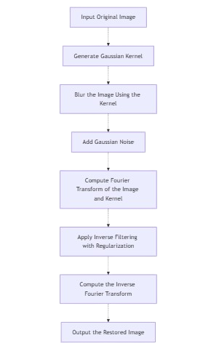
Proposed Solution/Methodology

Slide 9
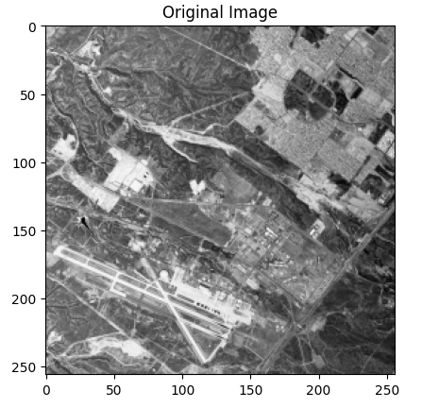
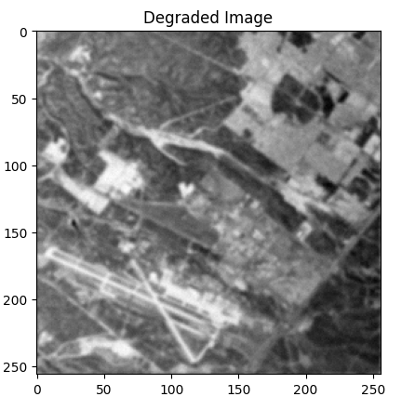
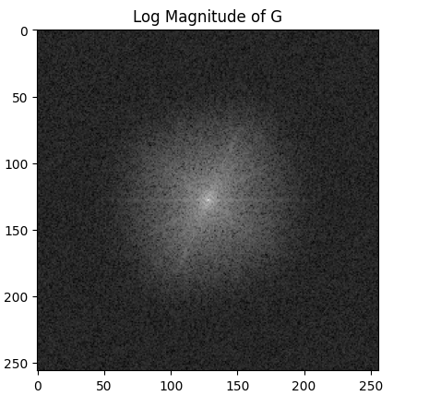
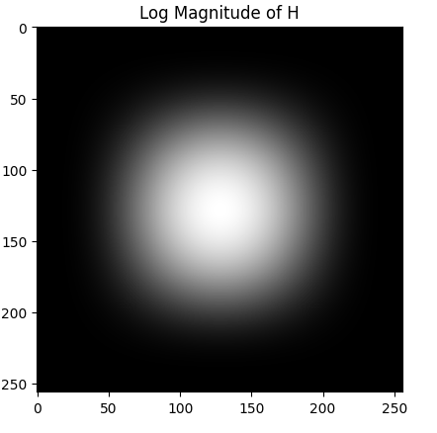
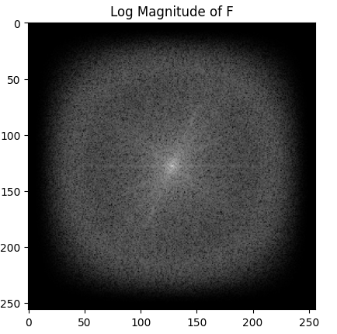
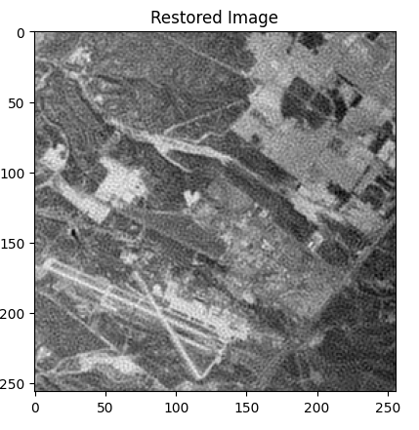
Results

Slide 10
Teamwork/Tasks Division
 | Literature Review | Code Implement | Presentation | Report
Muhammad Hassan | ✔✔✔ | ✔✔✔ | ✔✔ | ✔✔
Abdul Muiz | ✔✔✔ | ✔✔ | ✔✔ | ✔✔✔
Syed Muhammad Hashir | ✔✔✔ | ✔✔ | ✔✔✔ | ✔✔
Sheryar Ahmed | ✔✔✔ | ✔✔✔ | ✔✔✔ | ✔✔✔

Slide 11
Conclusion
Investigated inverse filtering for image restoration to address blur and noise.
Applied frequency-domain techniques for deblurring and denoising.
Identified challenges like sensitivity to noise and division-by-zero issues.
Introduced regularization techniques to enhance stability.
Demonstrated quality improvement in degraded images under specific conditions.
Highlighted limitations such as noise amplification at edges and flat regions.
Emphasized the importance of parameter selection for optimal results.
Proposed further studies on advanced and robust restoration algorithms.

